Slide 1

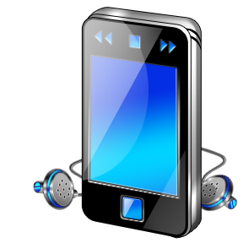

F
I
R
S
T
C
O
R
N
A
N
I
T
H
I
S
14.1-12
A free CD of this message will be available following the service
It will also be available for podcast later this week at calvaryokc.com

Slide 2
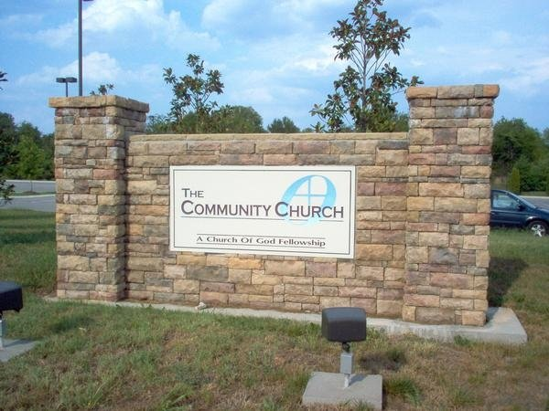
Has the heaviness of your old fashioned church got you weighted
down? Try us!
the
LiteChurch ©
of the Valley
We are the new
and improved
LiteChurch © of
the Valley.
O
A
N
S
14.1-12
I
I
F
I
R
S
T
C
R
N
T
H

Slide 3
Studies have shown we have 24% fewer commitments than other
churches.
the
LiteChurch ©
of the Valley
We guarantee
to trim guilt because we are Low Cal …
Low Calvinism that is
O
A
N
S
14.1-12
I
I
F
I
R
S
T
C
R
N
T
H

Slide 4
We are the home of the 7.5% tithe.
We promise 35-minute worship services with
7-minute sermons.
the
LiteChurch ©
of the Valley
Next Sunday's
exciting text is
the story of the feeding of the 500.
O
A
N
S
14.1-12
I
I
F
I
R
S
T
C
R
N
T
H

Slide 5
We have only 6 commandments
– your choice!
We use just 3
gospels in our
Contemporary
New Testament,
the
LiteChurch ©
of the Valley
“Good sound
Bites for Relevant human beings”
O
A
N
S
14.1-12
I
I
F
I
R
S
T
C
R
N
T
H

Slide 6
We take the offering every other week …
auto-debit services
Available
upon request.
the
LiteChurch ©
of the Valley
Yes, the new
and improved
LiteChurch © of
the Valley could be just what you are looking for.
O
A
N
S
14.1-12
I
I
F
I
R
S
T
C
R
N
T
H

Slide 7
We are everything you want in a church
… And Less!
the
LiteChurch ©
of the Valley
O
A
N
S
14.1-12
I
I
F
I
R
S
T
C
R
N
T
H

Slide 8
Desire - zēloō – zealous
Prophecy - prophēteia – to speak forth
Forth -telling more than fore -telling
John Calvin – “The peculiar gift of explaining revelation”
O
A
N
S
14.1-12
I
I
F
I
R
S
T
C
R
N
T
H

Slide 9
Teaching is making the Word of God known
Prophecy is making the Mind of God known
O
A
N
S
14.1-12
I
I
F
I
R
S
T
C
R
N
T
H

Slide 10
Acts 2.8-11 - ⁸ And how is it that we hear, each in our own language in which we were born? ⁹ Parthians and Medes and Elamites, those dwelling in Mesopotamia, Judea and Cappadocia, Pontus and Asia, ¹⁰ Phrygia and
O
A
N
S
14.1-12
I
I
F
I
R
S
T
C
R
N
T
H

Slide 11
Pamphylia, Egypt and the parts of Libya adjoining Cyrene, visitors from Rome, both Jews and proselytes, ¹¹ Cretans and Arabs —we hear them speaking in our own tongues the wonderful works of God.
O
A
N
S
14.1-12
I
I
F
I
R
S
T
C
R
N
T
H

Slide 12
Acts 10:46 - … they heard them speak with tongues and magnify God.
O
A
N
S
14.1-12
I
I
F
I
R
S
T
C
R
N
T
H

Slide 13
The church - literally, a church (local application)
O
A
N
S
14.1-12
I
I
F
I
R
S
T
C
R
N
T
H

Slide 14
Whitney Capps – “It’s easy to love and serve a sexy church. But to love and serve a struggling one, that’s another level of Christ-likeness.”
O
A
N
S
14.1-12
I
I
F
I
R
S
T
C
R
N
T
H

Slide 15

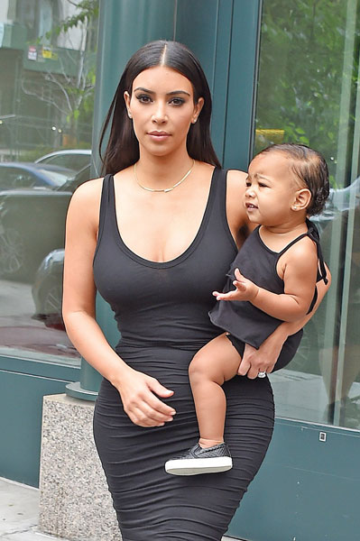
New for 2015!!!
Kim Kardashian to give birth to Martian baby!
O
A
N
S
14.1-12
I
I
F
I
R
S
T
C
R
N
T
H

Slide 16
“In promulgating your esoteric cogitations or articulating your superficial sentimentalities, and amicable philosophical or psychological observations, beware of platitudinous ponderosity.”
O
A
N
S
14.1-12
I
I
F
I
R
S
T
C
R
N
T
H

Slide 17
“Let your conversational communications possess a compacted conciseness, a clarified comprehensibility, a coalescent cogency, and a concatenated consistency.”
O
A
N
S
14.1-12
I
I
F
I
R
S
T
C
R
N
T
H

Slide 18
“Eschew obfuscation and all conglomeration of flatulent garrulity, jejune babblement, lofty loquaciousness and asinine affectations.”
O
A
N
S
14.1-12
I
I
F
I
R
S
T
C
R
N
T
H

Slide 19
“Let your extemporaneous descantings and unpremeditated expatiations have intelligibility and voracious vivacity without rodomontade or thrasonical bombasts.”
O
A
N
S
14.1-12
I
I
F
I
R
S
T
C
R
N
T
H

Slide 20
“Sedulously avoid all polysyllabic profundity, pompous prolificacy, and vain vapid verbosity.”
In Other words, “Be brief and don't use big words.”
O
A
N
S
14.1-12
I
I
F
I
R
S
T
C
R
N
T
H

Slide 21
“It's imperious that you procure numinous expiation or encounter the inauspicious and foreboding consequences of interminable proscription”
“get saved or else!”
O
A
N
S
14.1-12
I
I
F
I
R
S
T
C
R
N
T
H

Slide 22
Foreigner - barbaros
O
A
N
S
14.1-12
I
I
F
I
R
S
T
C
R
N
T
H

